Slide 1
Return To Work Re-Integration Plan
Training Presentation

Slide 2
Developed Return To Work Re-Integration Plan
Nothing is more important than the health and safety of our employees, visitors, customers and contractors.
We followed guidance from global and public health experts to do all we can to keep people healthy when considering resuming normal work activities.
GOAL: Work Together to Stop the Spread of COVID-19 and Maintain Healthy People at Work
This presentation details actions taken and changes made within the production areas to ensure the health and safety of all employees while returning to work
Goal = Working Together To Stop the Spread of COVID-19, Healthy People At Work
Notes:
Nothing is more important than the health and safety of our workforce, customers and communities.
Therefore, when we started work to reopen our facilities, we followed the guidance from global health experts to do all we can to keep our people healthy.
A goal was established: Work Together to Stop the Spread of COVID-19 and Maintain Healthy People at Work.
To achieve this, a playbook was developed to detail the actions that needed to be taken and the changes that would have to be made within the production areas to ensure the health and safety of all employees while returning to work in the best manufacturing facilities in the world!
Through alignment with the Union, Manufacturing Operations, Corporate Medical, Corporate Safety, Corporate Industrial Hygiene, Labor Affairs, and many others, we feel these actions will achieve our goal to keep people safe, stop the spread of COVID-19, and restart production in our facilities.
A comprehensive training plan was developed to establish ownership and cascade messaging from executive leadership through the Operating Committee Members down to the plant floor
Specific training has been developed for process coaches including: playbook presentation, SPLs, checklist and visual factory documents

Slide 3
Return To Work Playbook Framework
What Happened While You Were Away
What Will Happen When Returning
What We Need To Do When Back To Work
Additional Information You Need To Know
Cleaning and Disinfecting
Physical Distancing Actions
Developed Plan, Communications and Training Strategy
Ensure Maximum Fresh Air
Return To Work Facility Checklist
Return to Work Message
Employee Self Assessments
Visitor Self Assessment
Temperature Scanning
Controlled People Flow
Improve separation between shifts
If You Have Symptoms, Don’t Return to Work
Follow Public Health Guidelines for Stopping the Spread of Germs
Practice Social Distancing
Ongoing Cleaning / Disinfecting
What to do if someone comes to work with symptoms?
Disinfecting / Cleaning Protocol If Confirmed Case Is Reported
Department Specific Items To Consider (not all inclusive)
Key Links
Frequently Asked Questions
Goal = Working Together To Stop the Spread of COVID-19, Healthy People At Work

Slide 4
What Happened While You Were Away

Slide 5
Increased Cleaning Of Stations and Common Areas
During shutdown - Increased cleaning and disinfection of all common areas.
  Allowed for opportunity to focus on areas normally unavailable
Cleaning and Disinfection took place in many areas
All workstations, reception areas, common areas, floors, lunch rooms, locker rooms, cabinets, doors, counters, conference rooms, tables, and many more.
Facility staff utilized disinfectant
Goal = Working Together To Stop the Spread of COVID-19, Healthy People At Work
Notes:
Cleaning and disinfecting of all workstations and all common areas was completed. Shutting down facilities allowed for the opportunity to focus on areas that are not normally available. Special emphasis was put on touch surfaces.
Deep cleaning and disinfection took place in many areas. This process was performed using cleaning and disinfecting products.

Slide 6
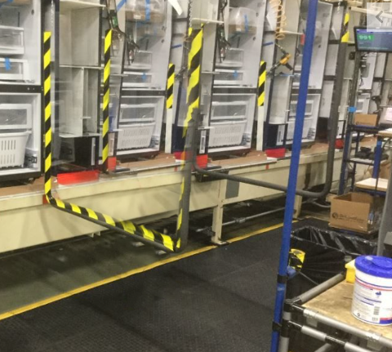
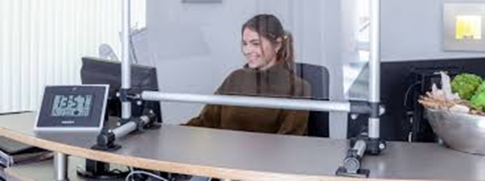


Implemented Physical Distancing Actions
Identified stations with less than 6 feet separation; mitigated physical distancing wherever possible
  Rebalanced work content, where possible, to create 6 feet of separation
    Implemented barriers / shields to limit person-to-person contact where required
  Alternate solutions (ex. Face Shields/safety glasses or other solutions) to be investigated if less than 6 feet of separation per workstation is required
Face Shield
Safety Glasses
Goal = Working Together To Stop the Spread of COVID-19, Healthy People At Work
Notes:
In addition to establishing guidelines for physical distancing, workstations were evaluated and workstations where less than 6 feet of separation existed were modified, where possible, to establish separation.
Work areas were rebalanced where possible to create 6 feet of separation
Barriers and/or shields were implemented to limit person-to-person contact
Alternative solutions (ex. Face Shields or other solutions) are available if less than 6 feet of separation per workstation mapping is required.

Slide 7
Defined Return to Work Communication Strategy –
Pre-Return To Work
Careful consideration was taken to ensure that employees are made aware of changes that are being implemented when returning to work
Several messages / initiatives identified to be included in Pre-Return to Work Communication
These messages / initiatives include:
  Letter to all employees from CAO/Clerk to all employees
  Memo to all employees from Joint Health and Safety Committee
  Information to all employees to get them ready for a re-integration
  Re-Integration plan training for all directors
  Re-Integration plan provided to local union leadership
  Department specific letter to employees with return to work instructions
  Employee Self-Assessment Survey that employees will complete prior to reporting to work
Goal = Working Together To Stop the Spread of COVID-19, Healthy People At Work
Notes:
Careful consideration was taken to ensure that employees are made aware of changes that are being implemented when returning to work.

Slide 8
Defined Return to Work Communication Strategy –
Post-Return To Work
In addition, several messages / initiatives identified to be included in Post-Return to Work Communication
These messages / initiatives include: (but are not limited to)
  Return to Work Message will be completed for all employees while observing physical distancing
  Use of signage to convey new health protocols throughout the facilities
  Daily completion of Self-Assessment Survey
  Directors and Managers observing behaviors in alignment to the Re-Integration Plan
  Support employees with open lines of communication to address ongoing concerns and needs for further information
Goal = Working Together To Stop the Spread of COVID-19, Healthy People At Work

Slide 9
Created Return To Work Facility Checklist
A facility Return To Work Checklist was created to focus on having actions in place to help stop the spread of COVID-19 and keep people inside of each facility healthy
Main categories of the checklist include:
  People
  Cleaning
  Communications
  Physical Distancing
Each facility is expected to complete checklist before employees report to work to ensure facility readiness
  To be completed once before startup; all items must be completed
Goal = Working Together To Stop the Spread of COVID-19, Healthy People At Work

Slide 10
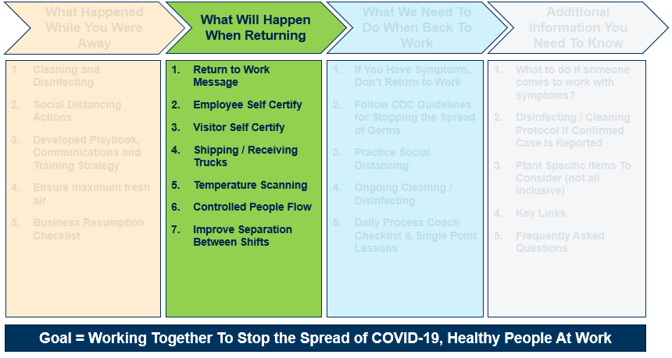
What Will Happen When Returning

Slide 11

Return to Work Message
Prior to re-integration employees will receive communication from leadership. This will consist of a letter from CAO/Clerk, memo from the Joint Health and Safety Committee and additional information will be sent to all employee’s homes
Return to Work Message to include:
  What Happened While You Were Away
  What We Can Do Together When Returning
  Importance of Working Together To Be Safe And Successful
Goal = Working Together To Stop the Spread of COVID-19, Healthy People At Work

Slide 12







Employee Return To Work – 3 Step Process
1
2
Temperature
Check
3
Face
Mask if can’t maintain 6 feet distance
Self Certification
Go
To Work

Slide 13
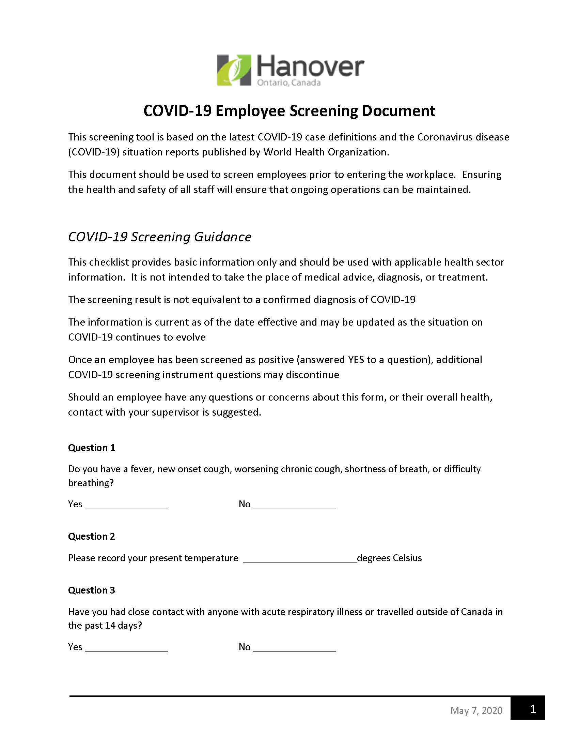
Employee Self-Assessment Survey
Prior to reporting for work, all employees will be encouraged to complete an at home assessment, reviewing their ability to report to work
  Self Assessment and temperature check when report to facility
  Employees must present survey confirmation as part of entry to the facility to their supervisor
  Requested for all Hourly, Salaried, Part time and Volunteer Employees
NOTE: External visitors and contractors will complete the same self assessment as part of the visitor health screening
Goal = Working Together To Stop the Spread of COVID-19, Healthy People At Work

Slide 14
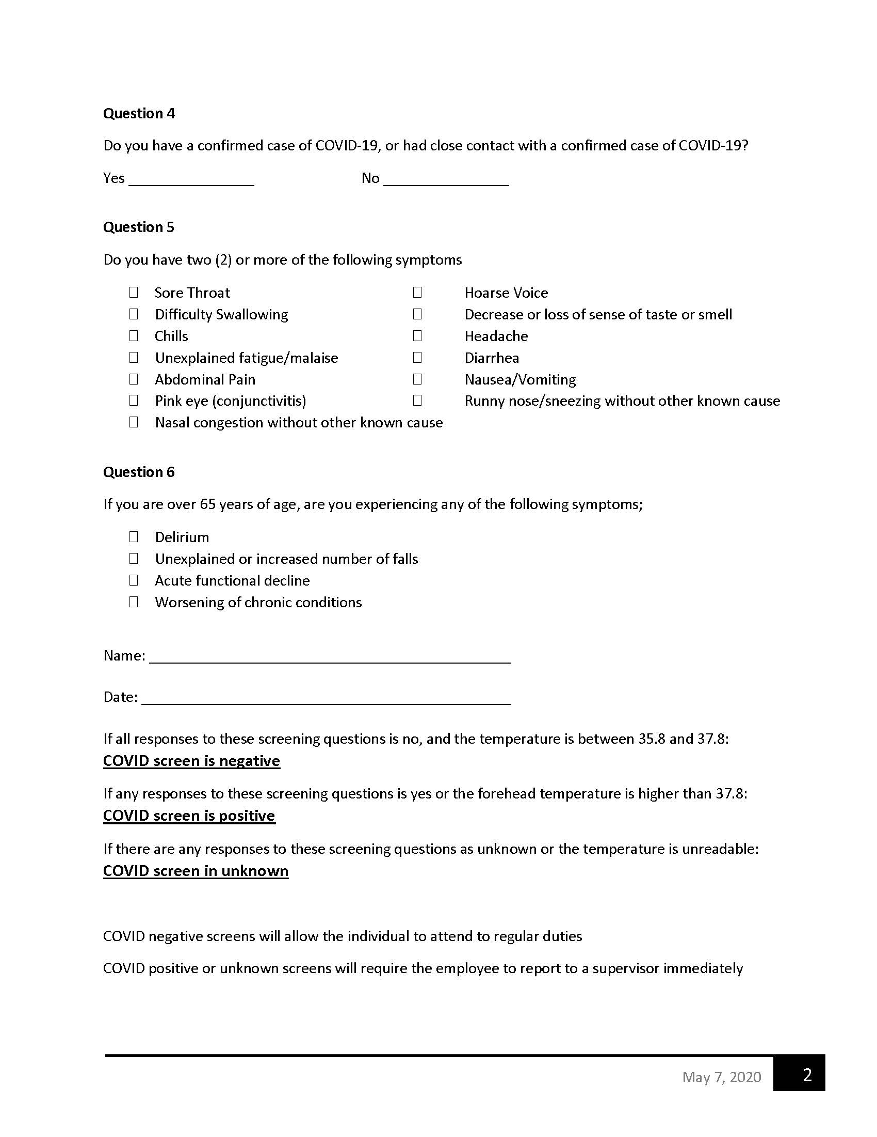
Employee Self-Assessment Survey (continued)
Survey questions are meant to assess the ability of an employee to come to work
  Survey must be completed daily / prior to the beginning of each shift
NOTE: External visitors and contractors will follow current Facility Visitor Procedure, including completion of the same health screening
If you are able to answer “YES” to one or more of the survey questions, you should not report to work. Contact your supervisor immediately by phone, and follow up with your healthcare provider and follow medical leave procedures.
If you are able to answer “NO” to all of the survey questions and don’t have an elevated temperature, you are expected to report to work. Please show your survey confirmation to your supervisor upon arrival at work.
Goal = Working Together To Stop the Spread of COVID-19, Healthy People At Work

Slide 15
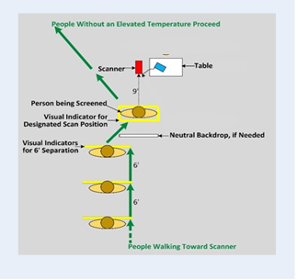
Entering the Building – Temperature Scanning
Upon entering the building, all employees will receive a temperature scan
  GOAL: Identify people with elevated temperature above the criteria to return to work; avoid them coming into the facility.
Scanning Process
Employees will complete a self scan using a infrared thermometer process
Employees with temperature within entry limit will be allowed to enter facility
Employees with temperature above entry limit will not be allowed to enter facility and will be asked to leave
Goal = Working Together To Stop the Spread of COVID-19, Healthy People At Work

Slide 16
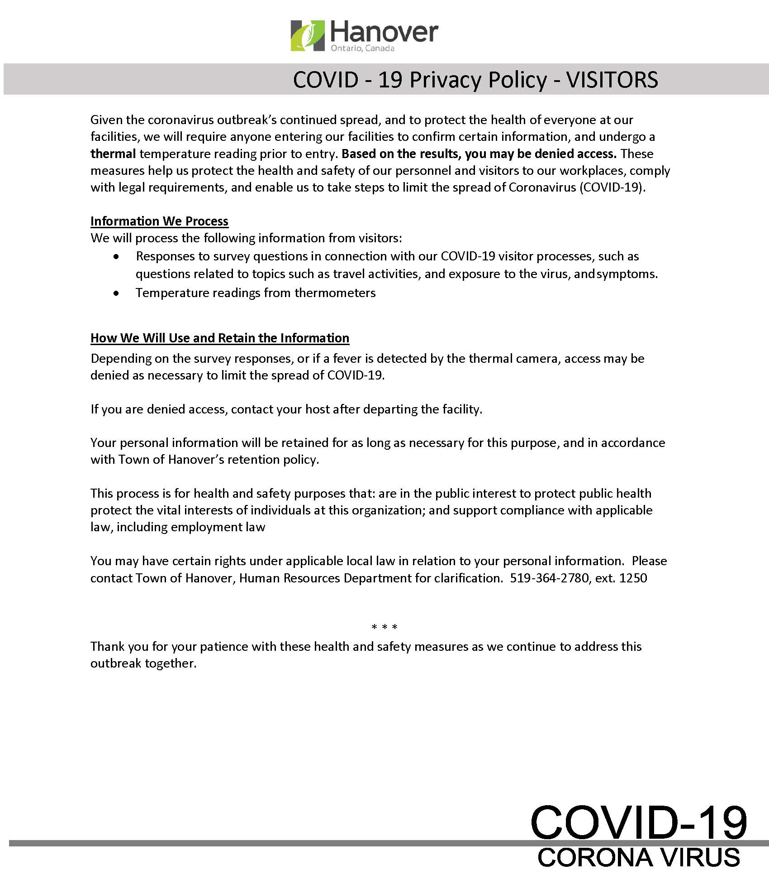
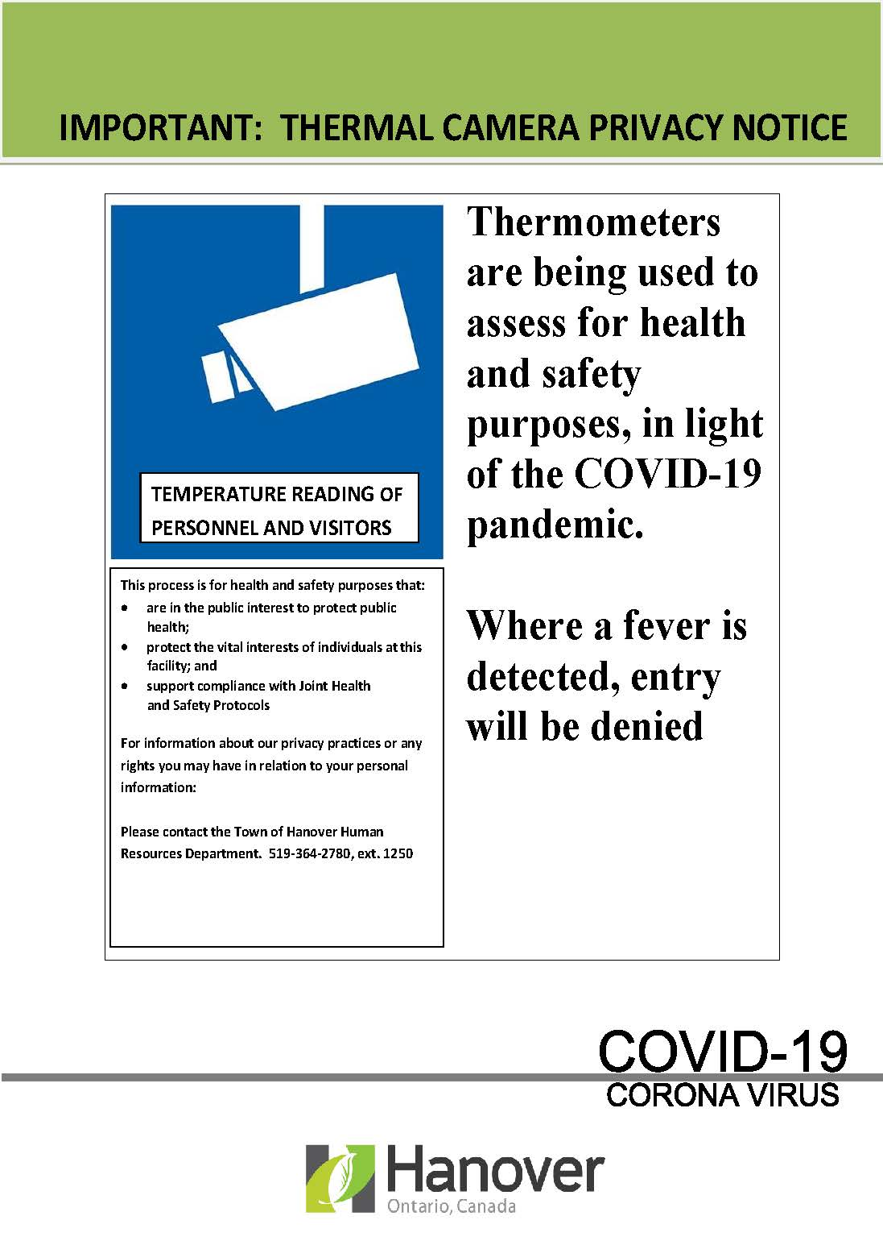
Temperature Scanning – Privacy Notices & Screening Results

Slide 17
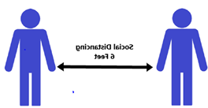
Controlling People Flow
Several measures should be considered to control the flow of people entering, while inside, and exiting facilities and establish physical distancing
  Designated work areas should be separated or controlled; specific entry/exit points should be established
  Employees should be asked to enter and exit the specific facility entrances
  Walking routes may need to be identified inside of the facility for high traffic areas.
  Limited lunchroom traffic, staggered start and end to shifts, etc. will be defined for each departmental group to use
Goal = Working Together To Stop the Spread of COVID-19, Healthy People At Work
Notes:
Maintaining physical distancing while not at the workstation is critical – employees are to enter only through designated entrances and only move within required areas.

Slide 18
Controlling People Flow – Improve Separation Between Shifts
Other elements that were examined to control people flow include: (but are not limited to)
  Improved shift-to-shift separation (which may involve utilizing ‘lunch at your desk or out the door’ where appropriate, or modifying shift start times to limit person-to-person contact and improve flow in and out of the facility
  Development and posting of information on new guidelines and recommendations on physical distancing behavior
Goal = Working Together To Stop the Spread of COVID-19, Healthy People At Work

Slide 19
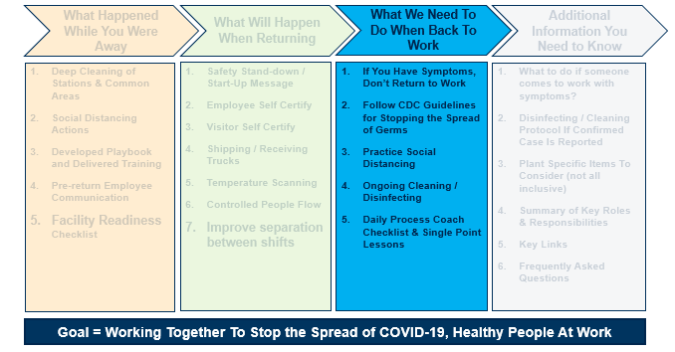
What We Need to Do When Back To Work

Slide 20
Employee Experience: Employee Care In The New Normal
The world we live in has changed, and the new normal can be very unsettling for many. Never before has leadership been more important. We have a unique opportunity during these unprecedented times to show, through our resilience and leadership that we aspire to be the World's Most Trusted Company.
Before
Returning
To Work
Provide transparent and concise communications preparing employees (physically and psychologically) for return
    Cleaning protocols, seating arrangements, health screening
Support employees in recognizing the need to balance work with responsibility of family
Encourage open communication about how and when employees return to work
Share emotional support resources with employees to help them prepare for the transition back to the workplace
The First
Day Back
and After…
Be flexible in expectations
    Do not expect employees to be 100% the first day back
    Allow for transition time (physically and psychologically)
    Employees may be unable to work their full scheduled shift (e.g., experiencing anxiety or feeling ill)
Lead with empathy
Share resources that encourage compassion for self and others (experiencing grief)
Support opportunities for employees to share their experiences
Recognize employees for the work being done

Slide 21



Personal Protective Equipment (PPE)
Face Masks
  A face mask is required to be worn by all employees, if a 6 foot perimeter can not be maintained
  Town of Hanover employees will be provided a face mask
  Visitors and Contractors will be required to wear a face mask.
Face Shields OR Safety Glasses W/Side Shields
  Personal face shields OR safety glasses are available to help protect personal space and supplement physical distancing efforts if these are required for your area.
  Protects others if you cough or sneeze; protects you if someone else coughs or sneezes
  Functions as a reminder to not touch your own face with your hands
Goal = Working Together To Stop the Spread of COVID-19, Healthy People At Work

Slide 22




Face Mask
Face Shield
OR
Safety Glasses
Does not protect eyes
Reduces Risk of asymptomatic or symptomatic person from spreading virus
Protects eyes, face and mouth from droplets
Helps to reduce frequency of face touching
Protects others if you cough or sneeze by reducing the spread of droplets
If you can’t maintain a 6 foot perimeter
WHY
WHY
MUST be worn by All Town of Hanover employees when a 6 foot perimeter cannot be maintained. All contractors and visitors must wear at all times
Workers in close proximity to others where physical distancing cannot be maintained
WHO
WHO
Not required for entry
WHERE
WHERE
Social Distancing

Slide 23
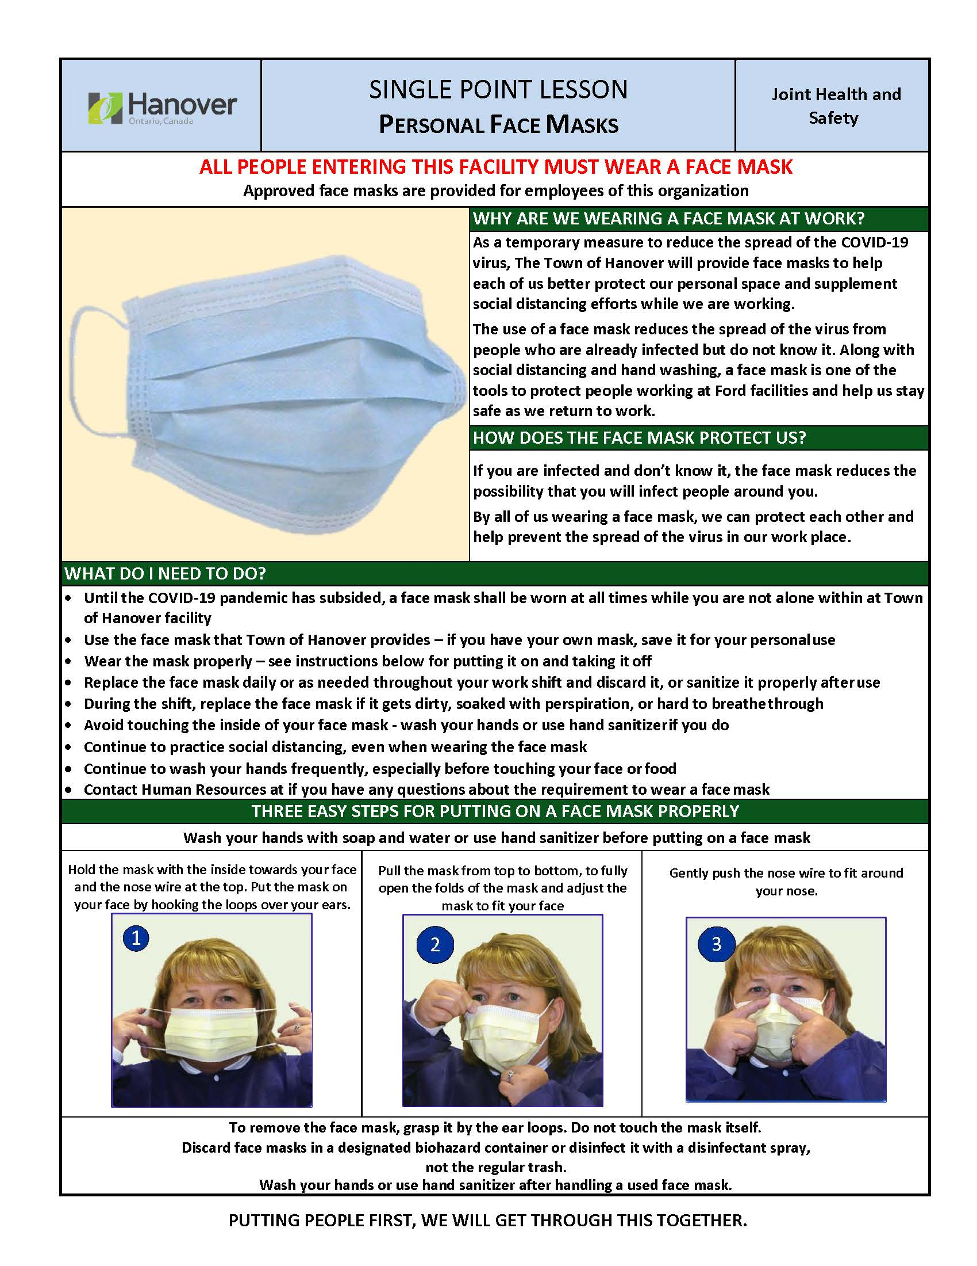
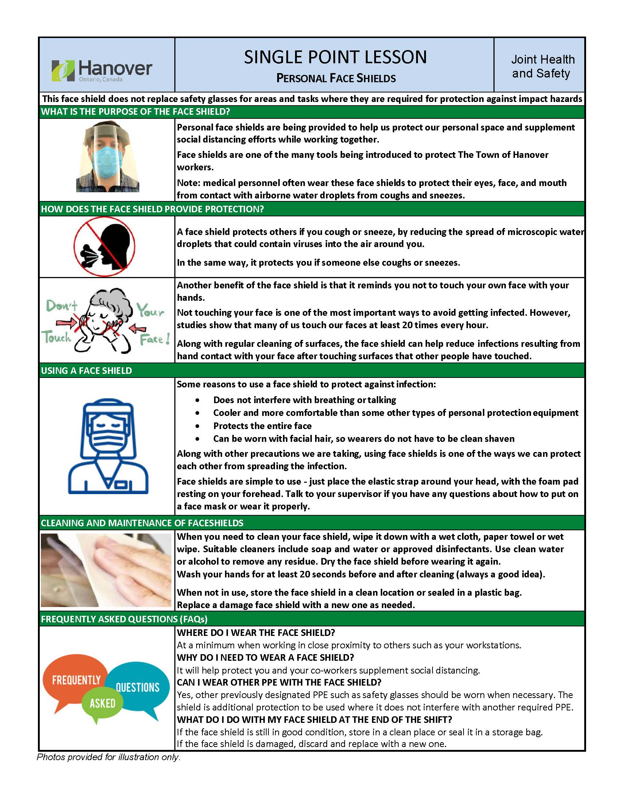
SPLs – Personal Face Masks / Personal Face Shields

Slide 24
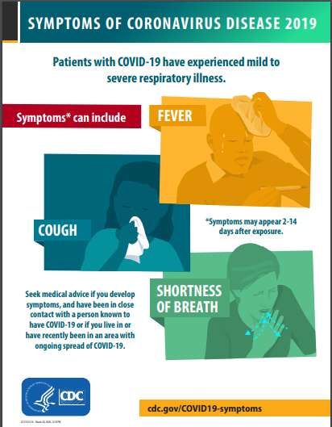
If You Have Symptoms, Do Not Come To Work
Before each shift, prior to reporting for work, all employees will be expected to complete an at home survey assessing their ability to report to work
  Survey to be completed prior to the beginning of each shift
  Survey questions are meant to assess the ability of an employee to come to work
  One of the questions asks the employee to assess if they have symptoms similar to COVID-19
Symptoms of COVID-19 include (but are not limited to):
  cold or flu-like symptoms (to include fever, cough, sore throat, respiratory illness, difficulty breathing)
  If experiencing these symptoms, you should not come to work; Follow up with your healthcare provider and follow medical leave procedures
Goal = Working Together To Stop the Spread of COVID-19, Healthy People At Work

Slide 25
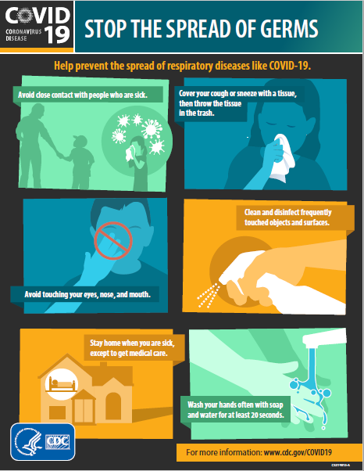

Practicing Social Distancing – Breaks & Lunch
Remember to follow physical distancing guideline to keep 6 feet of separation
Before Meal:
Keep Social Distancing (6 feet separation)
Wash Hands per the public health guidelines
While Eating:
Keep Social Distancing (6 feet separation)
Eat at your desk, outside the building or in limited lunchroom seating
After Eating:
Keep Social Distancing (6 feet separation)
Throw trash away in trash containers
Wash Hands per the public guidelines
Goal = Working Together To Stop the Spread of COVID-19, Healthy People At Work

Slide 26
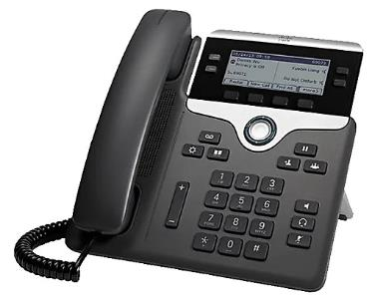

Practicing Social Distancing – Meetings
In principle, no face to face group meetings (limit as much as possible)
  If conducting in-person group meetings, maintain 6 feet of separation
  Minimize meeting time as much as possible to limit potential person-to-person contact
Use conference calls /Zoom meetings, wherever possible, to conduct group meetings
Employees should refrain from using other workers’ phones, desks, offices, pens or other work equipment, when possible.
Work areas should be disinfected at the mid-point and end of each shift.
Goal = Working Together To Stop the Spread of COVID-19, Healthy People At Work

Slide 27
Practicing Social Distancing – Outside of Work
Even at home, you can do your part to stop the spread of COVID-19
Follow Public Health guidelines for Stopping the Spreading of Germs
  Avoid close contact with people who are sick
  Avoid touching your eyes, nose, and mouth
  Stay home when you are sick, except to receive medial care
  Cover your cough or sneeze with a tissue, then throw the tissue in the trash
  Clean and disinfect frequently touched objects and surfaces
  Wash your hands often with soap and water for at least 20 seconds
Goal = Working Together To Stop the Spread of COVID-19, Healthy People At Work

Slide 28

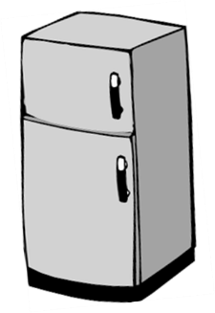

Defined Cleaning Protocols - Breaks & Lunch
Team Break Areas– Available (limited staff at one time)
  Cleaned by Facility Team
Microwaves and ‘appliances’ – Available
  Cleaned by staff after each use
Clean Microwave After Each Use
Goal = Working Together To Stop the Spread of COVID-19, Healthy People At Work

Slide 29
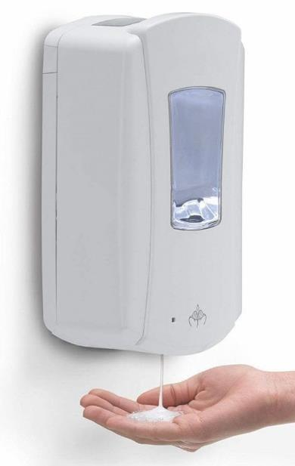
Defined Cleaning Protocols – Established Hand Sanitizer Locations
Public Health recommends everyone wash your hands often with soap and water for at least 20 seconds
Hand sanitizer distribution locations were established for areas where employees may not have immediate access to restrooms / locker rooms, or areas with sinks where soap and water are available
NOTE: Cleaning hands at key times with soap and water or hand sanitizer is one of the most important steps you can take to avoid getting sick and spreading germs to those around you. Hand sanitizers may not remove harmful chemicals, such as heavy metals like lead. Hand sanitizers may not be as effective when hands are visibly dirty or greasy. While hand sanitizers can be used, it is still highly recommended to practice recommended handwashing with soap and water for at least 20 seconds.
Goal = Working Together To Stop the Spread of COVID-19, Healthy People At Work

Slide 30
Defined Cleaning Protocols – Established Hand Sanitizer Locations (continued)
Locations where hand sanitizer will be available include: (but are not limited to)
  Administration building main entrance / lobby
  Employee main entrance
  Separated buildings main entrance
  Main stairways / elevators with high people usage
  Breakrooms without sinks
Goal = Working Together To Stop the Spread of COVID-19, Healthy People At Work

Slide 31
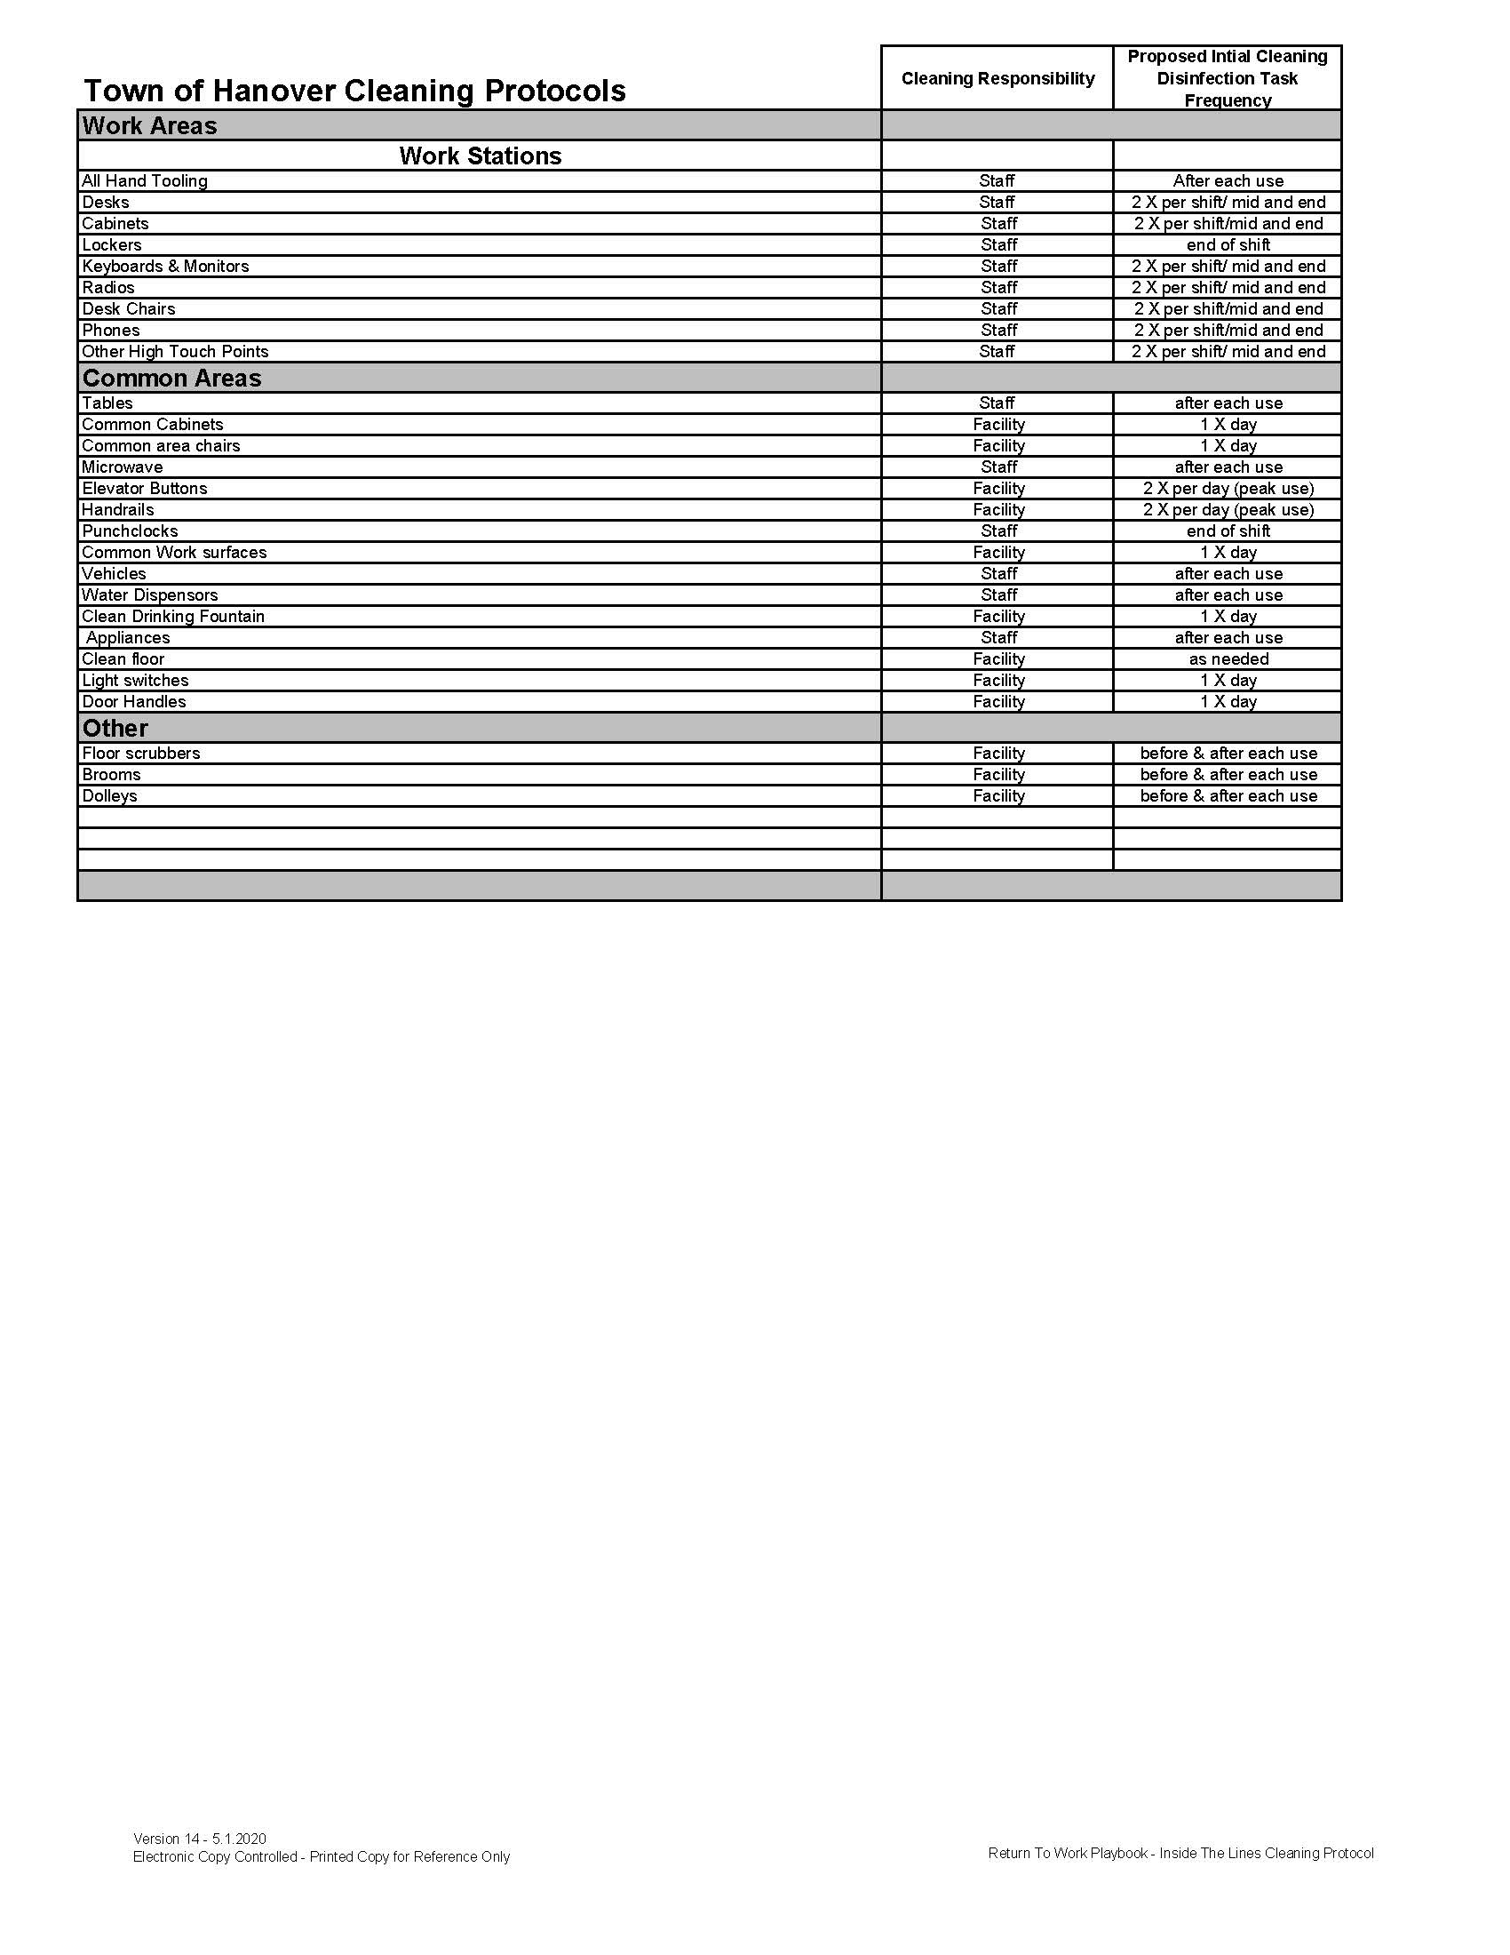
Cleaning Protocol
A cleaning protocol was established so that it could be clearly identified how often cleaning should take place, and by whom.
Documentation should be taken by each department.
Monthly inspections will be modified to ensure that COVID-19 related documentation is taking place such as this.
JHSC members may request cleaning documentation at any time during monthly inspections.
Goal = Working Together To Stop the Spread of COVID-19, Healthy People At Work

Slide 32
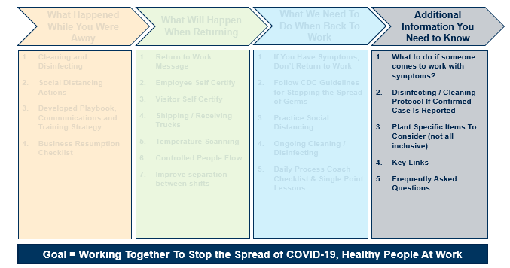
Additional Information You Need to Know

Slide 33
Action Plan - Employee Showing COVID-19 Symptoms At Work
In all situations, maintain physical distancing of six feet from individual and ask them to move away from other employees
Arrange for the affected worker to be transported home or to an emergency department, dependent upon severity of symptoms.
    If employee is in acute respiratory distress (shortness of breath, difficulty speaking, wheezing, gasping for air), then outside emergency medical services are contacted.
    If employee is not in acute respiratory distress, they will be advised to go home, monitor their symptoms, contact their personal healthcare provider for further direction / advice, as needed, and meet specific criteria before returning to a Town of Hanover facility.
    Advise HR of the situation to begin illness notification
Goal = Working Together To Stop the Spread of COVID-19, Healthy People At Work

Slide 34
Action Plan - Employee Showing COVID-19 Symptoms At Work (continued)
Contact Tracing
  HR to complete contact tracing (include all areas where the individual had been including work station, restrooms, break area)
  HR to talk to close contacts* to verify possible exposure
  Close contacts should be advised to seek consultation with their healthcare professional and are encouraged to self-quarantine for 14-days
  If close contacts are symptomatic, then HR must identify the close contacts of the close contact
  Strict confidentiality will be maintained throughout the contact tracing process
Disinfection
  If confirmed case, by testing or confirmed clinically by their healthcare professional; notify Facility Team to complete disinfection following their protocol; of the areas the employee was in (work station, break areas, restrooms, etc.)
*Close Contact is defined as being within approximately 2 meters (6 feet) of a COVID-19 case for a prolonged period of time or having direct contact with infectious secretions of a COVID-19 case (e.g., being coughed on)
Goal = Working Together To Stop the Spread of COVID-19, Healthy People At Work

Slide 35
Defined Cleaning Protocols – Confirmed Cases
Case confirmed, social path and contacts understood
Cleaning protocol governed by time since employee was last in the work place
  1 Day (up to 24hrs) from employee last at work to confirmation
      Work area, equipment, and team area cleaning along with employee social path – deep or enhanced cleaning
  2 – 3 Days (24-72hrs) from employee last at work to confirmation
      Work area, equipment, and team area along with employee social path - enhanced cleaning
  Greater Than 3 Days from employee last at work to confirmation
      Maintain work station and facility standard cleaning plans
Goal = Working Together To Stop the Spread of COVID-19, Healthy People At Work

Slide 36
Defined Cleaning Protocols – Cleaning Definitions
Deep Clean
  Area impacted is closed to access (until cleaning is completed and verified)
  Danger tape used to identify the area in need of cleaning
  Service professional performs work with specialized equipment and techniques (airborne disinfectant)
  Cleaning can be performed for the full or partial facility footprint (social habit / path)
  Donning of Personal Protective Equipment (i.e., hazmat suits and respirators)
Enhanced Clean
  Area impacted is closed to access (until cleaning is completed and verified)
  Danger tape used to identify the area in need of cleaning
  Facility team uses approved cleaning and sanitizing products
  Cleaning includes detailing of all desks and surfaces in area of identified employee; All identified area of social habits and paths identified by the impacted employee are to be sanitized
  All high tactile areas (listed in Standard Clean definition) continue to be cleaned twice per day
Standard Clean
  Building is open
  Facility team and staff use approved cleaning and sanitizing products
  All high tactile areas (including but not limited to – door handles, hand rails, conference rooms, elevators, escalators, kitchenette, restrooms) cleaned as per cleaning protocol
Goal = Working Together To Stop the Spread of COVID-19, Healthy People At Work

Slide 37
Specific Items To Consider (not all inclusive list)
  How to handle restroom breaks
  How to implement cleaning protocols, including jobs with rotations
  How to distribute cleaning supplies
  How to implement Shift-to-Shift separation
  Entry and Exit locations
  PPE supply
  Hazards and Controls
  High traffic areas and flow
  Combining waste containers
  Reducing touch points
  Removal of pamphlets and swag from reception areas
  Elimination of shared work desks
Goal = Working Together To Stop the Spread of COVID-19, Healthy People At Work

